Slide 1

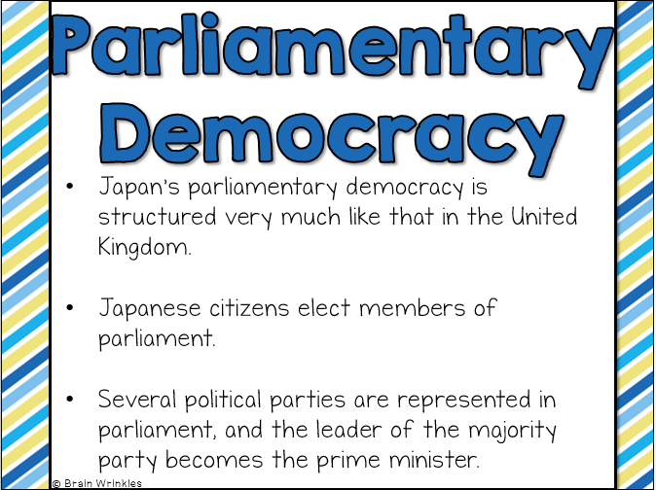
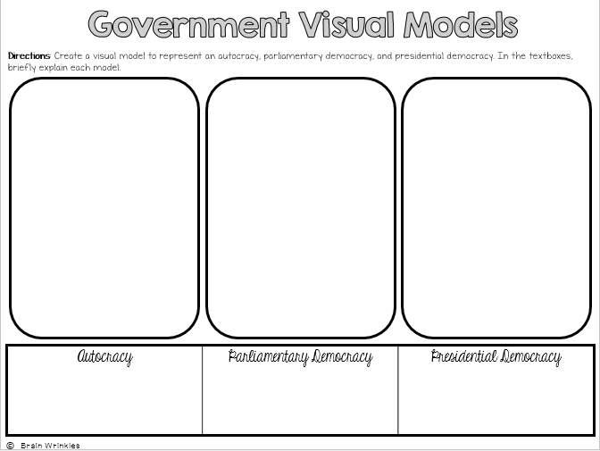
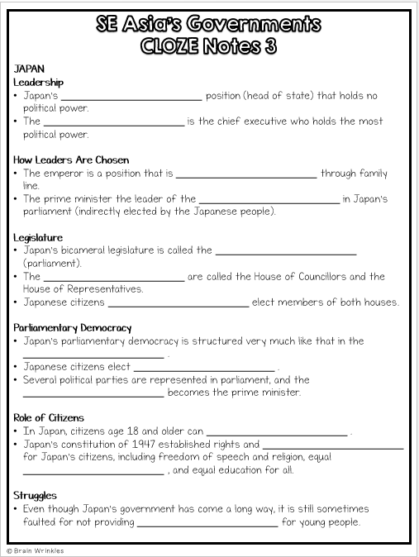
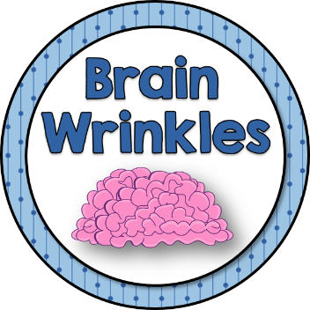
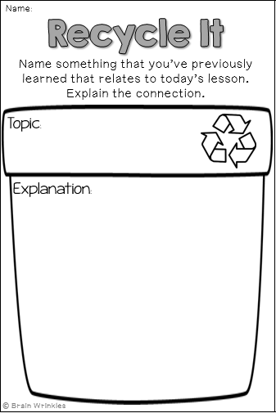
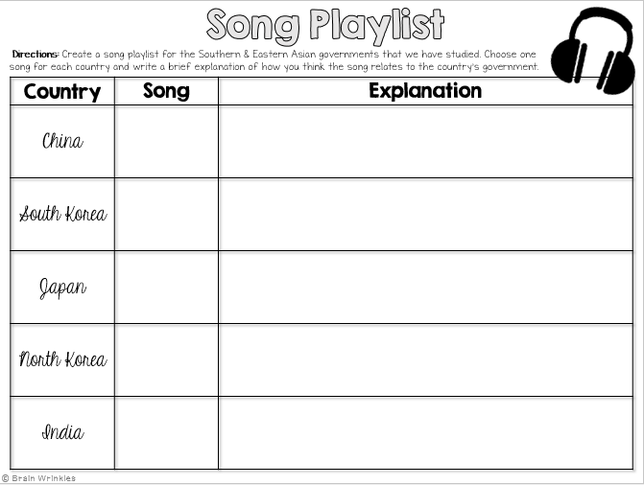
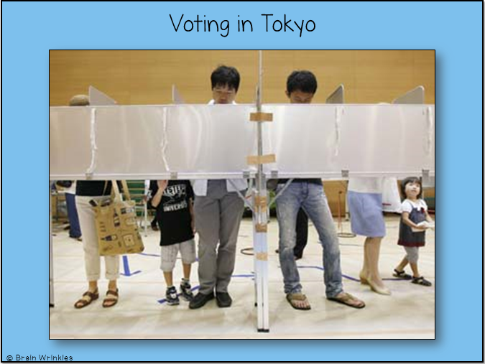
Southern & Eastern Asia’s
GOVERNMENTS
GOVERNMENTS
Presentation, Graphic Organizers, & Activities

Slide 2
STANDARDS:
SS7CG4 Compare and contrast various forms of government.
Explain the role of citizen participation in autocratic and democratic governments [i.e. explain the role of citizens in choosing the leaders of China (communist state), Japan (parliamentary democracy), North Korea (autocracy), South Korea (presidential democracy), and India (parliamentary democracy)].
Describe the two predominant forms of democratic governments: parliamentary and presidential.
© Brain Wrinkles

Slide 3


Southern & Eastern Asia’s
GOVERNMENTS
© Brain Wrinkles

Slide 4
Let’s Review
How do citizens participate in government?
AUTOCRACY: citizens have a very limited role in government; one person has all of the power
DEMOCRACY: supreme power is vested in the people & exercised by them directly or indirectly through a system of representation involving free elections
© Brain Wrinkles

Slide 5
Governments
Southern and Eastern Asia has a number of democratic governments, as well as several autocratic governments.
In the autocracies, the Communist states identify as republics, but give autocratic power to the Communist Party.
For example, China and North Korea are both autocratic governments where state control is high and citizens’ rights are limited.
© Brain Wrinkles

Slide 6
Let’s Review
What are the two types of democratic governments?
PARLIAMENTARY: citizens elect members of Parliament, and then the members select the leader.
  The leader works with or through the legislature.
PRESIDENTIAL: system of government in which the leader is constitutionally independent of the legislature.
  Citizens directly elect leader, who works separately from legislature.
© Brain Wrinkles

Slide 7
DEMOCRACIES:
India, Japan, & South Korea
© Brain Wrinkles

Slide 8
INDIA
Parliamentary Democracy
© Brain Wrinkles

Slide 9
Background
Great Britain colonized and ruled India from the 1600s until the mid-1900s.
In 1947, India gained its independence from Great Britain and a parliamentary democracy was put into place.
Today, there are still influences of European colonization in India’s government.
© Brain Wrinkles

Slide 10
Leadership
The prime minister is the chief executive of the national government that holds the most political power.
The president is the head of state who performs mostly ceremonial duties and holds little political power.
© Brain Wrinkles

Slide 11
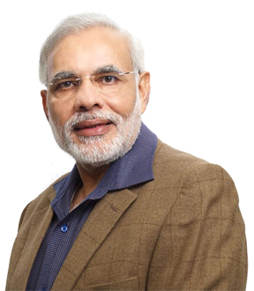
Narendra Modi
India’s Prime Minister
© Brain Wrinkles

Slide 12
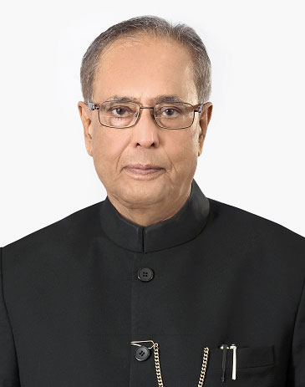
Pranab Mukherjee
India’s Prime Minister
© Brain Wrinkles

Slide 13
How Leaders
Are Chosen
The prime minister is elected by members in parliament from the majority party.
  Citizens elect members of parliament, and then the members vote for prime minister.
The president is elected by an electoral college consisting of elected members of Parliament and the legislatures of the states.
© Brain Wrinkles

Slide 14
Legislature
India’s bicameral legislature is called the Sansad (parliament).
The two houses are called the Council of States and the House of the People.
Membership in the Council of States is chosen by assemblies in India’s states.
Indians age 18 and older elect all but two members of the House of the People; the president appoints the final two members.
© Brain Wrinkles

Slide 15
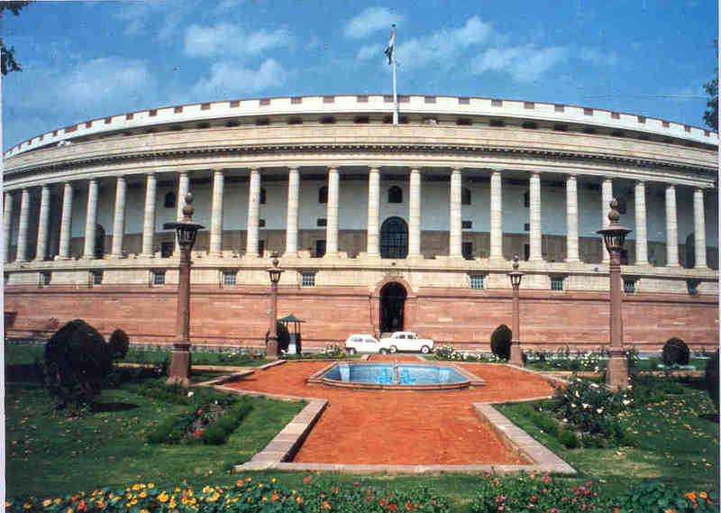
Sansad Bhavan – India’s Parliament Building
© Brain Wrinkles

Slide 16
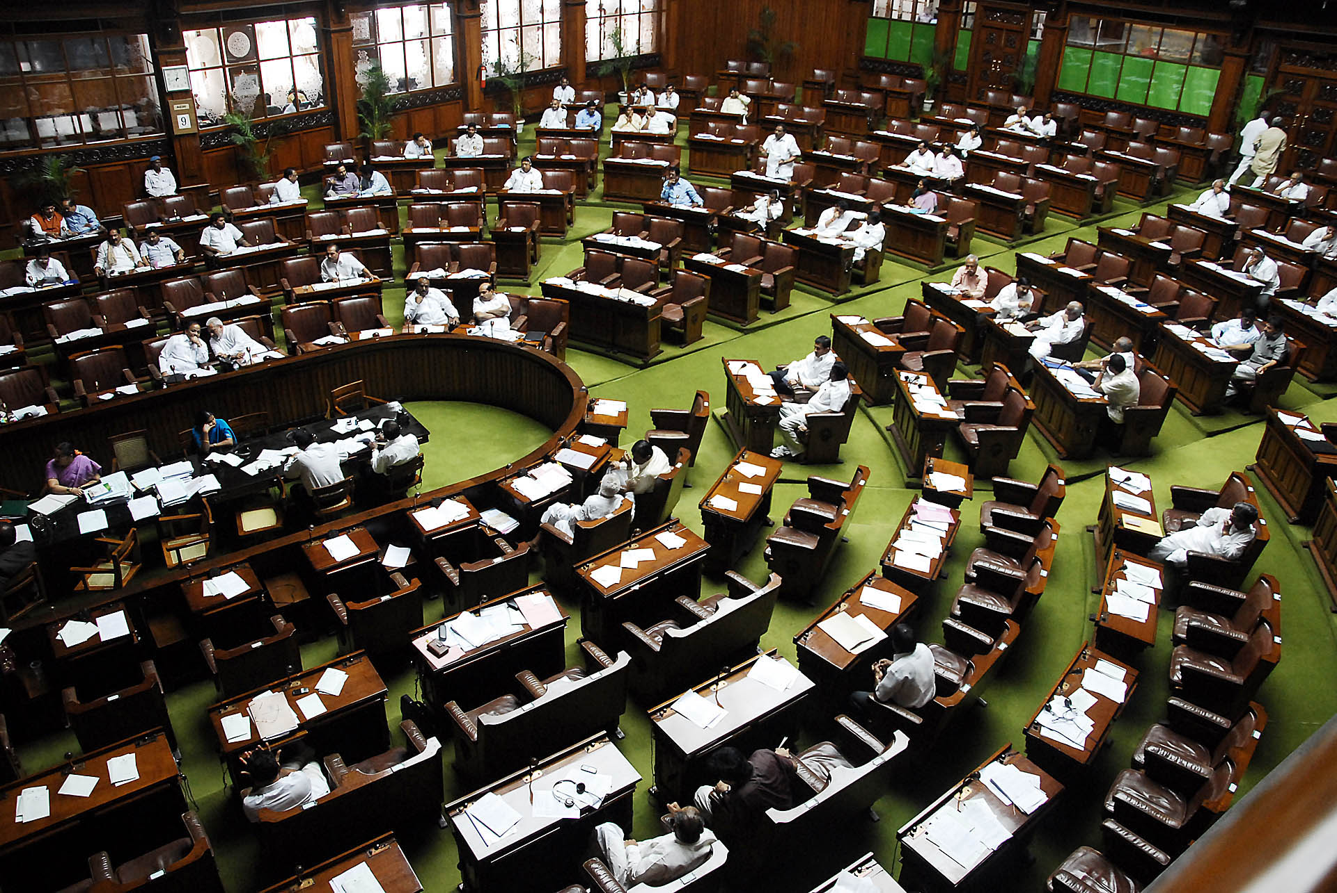
Inside the House of the People
© Brain Wrinkles

Slide 17
Parliamentary
Democracy
In India’s parliamentary democracy, citizens elect members to the House of the People.
The members of Parliament then elect a leader from the majority party in the Sansad.
The prime minister works with or through the legislature.
© Brain Wrinkles

Slide 18
Role of
Citizens
The Indian Constitution of 1950 granted many rights and personal freedoms to Indian citizens.
India’s Constitution also guarantees equality for women.
All Indians over the age of 18 are guaranteed the right to vote.
© Brain Wrinkles

Slide 19
Role of
Citizens
Indians also have freedom of speech, freedom of religion, freedom of assembly, and many other freedoms similar to those in the US and European democracies.
They are also given the right to conserve their language and culture.
© Brain Wrinkles

Slide 20
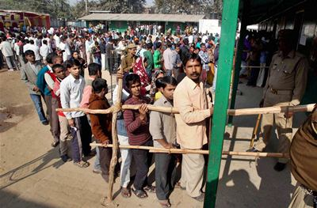
Voting Lines in Delhi
© Brain Wrinkles

Slide 21
Struggles
In India, there are some discrimination complaints that arise from traditional practices.
Elements of India’s former caste system still remain in some parts of the country, and the way of life for “untouchable” workers is still very difficult.
© Brain Wrinkles

Slide 22
JAPAN
Parliamentary Democracy
© Brain Wrinkles

Slide 23
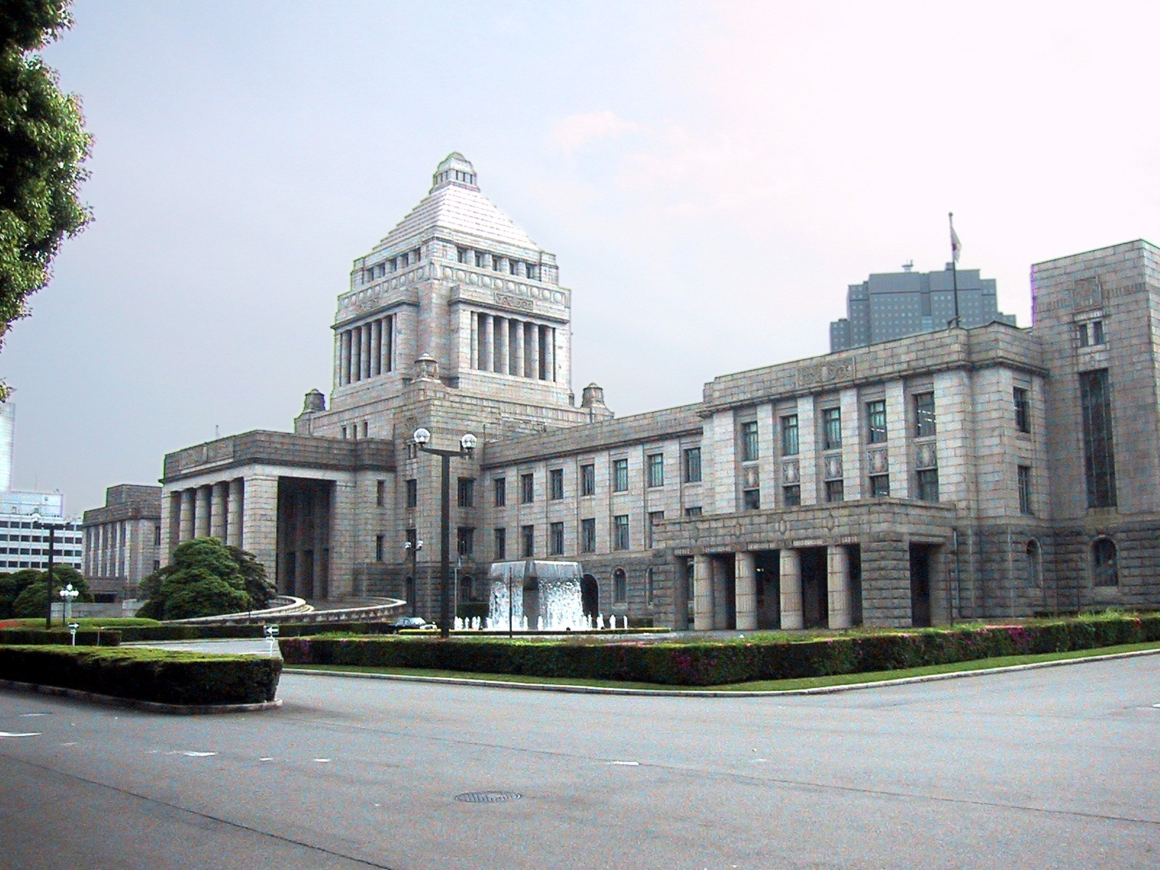
Japan’s Diet Building in Tokyo
© Brain Wrinkles

Slide 24
Leadership
Japan’s emperor is ceremonial position (head of state) that holds no political power.
The prime minister is the chief executive who holds the most political power.
© Brain Wrinkles

Slide 25
How Leaders
Are Chosen
The emperor is a position that is inherited through family line.
The prime minister the leader of the majority party in Japan’s parliament (indirectly elected by the Japanese people).
© Brain Wrinkles

Slide 26
Legislature
Japan’s bicameral legislature is called the Diet (parliament).
The two houses are called the House of Councillors and the House of Representatives.
Japanese citizens age 18 and older elect members of both houses.
© Brain Wrinkles

Slide 27
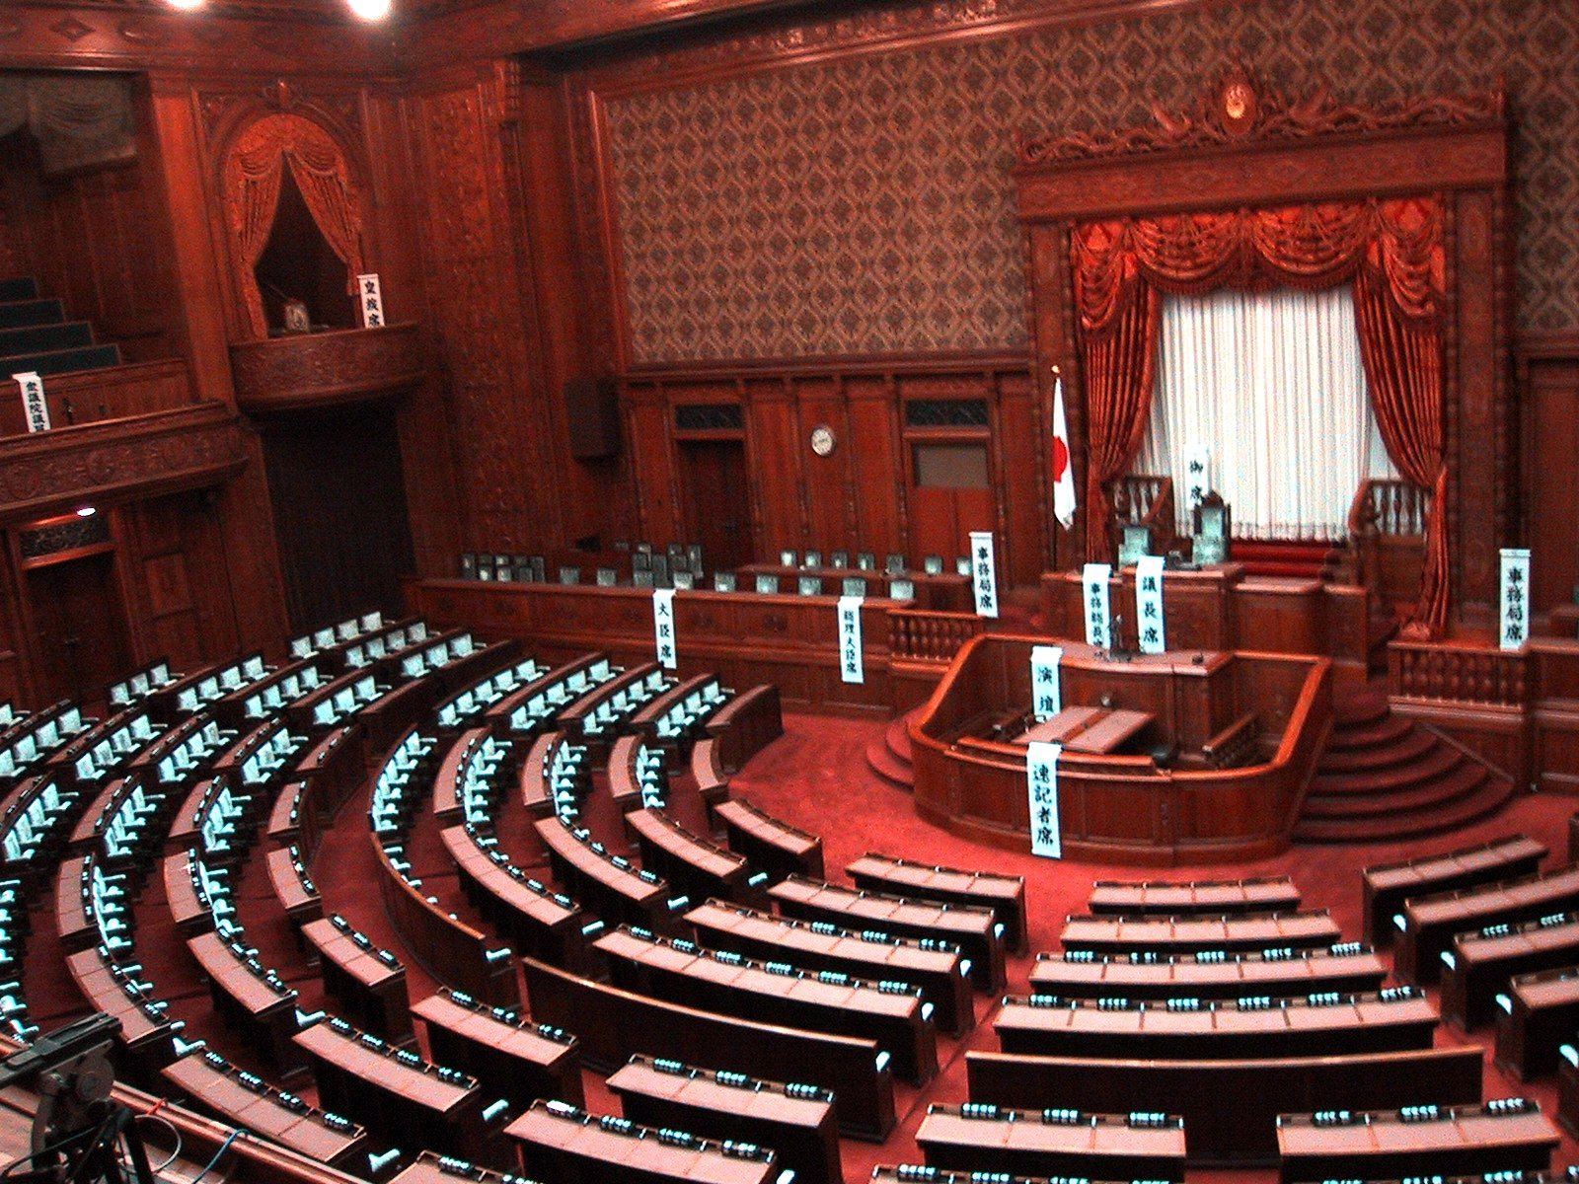
© Brain Wrinkles

Slide 28
Parliamentary
Democracy
Japan’s parliamentary democracy is structured very much like that in the United Kingdom.
Japanese citizens elect members of parliament.
Several political parties are represented in parliament, and the leader of the majority party becomes the prime minister.
© Brain Wrinkles

Slide 29
Role of
Citizens
In Japan, citizens age 18 and older can vote in elections.
Japan’s constitution of 1947 established rights and personal freedoms for Japan’s citizens, including freedom of speech and religion, equal rights for women, and equal education for all.
© Brain Wrinkles

Slide 30
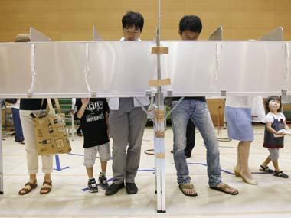
Voting in Tokyo
© Brain Wrinkles

Slide 31
Struggles
Even though Japan’s government has come a long way, it is still sometimes faulted for not providing enough opportunities for young people.
© Brain Wrinkles

Slide 32
SOUTH KOREA
Presidential Democracy
© Brain Wrinkles

Slide 33
Background
In the early 1900s, the Republic of Korea was a military dictatorship.
The country has come a long way and is now a presidential democracy that supports individual rights and freedoms.
© Brain Wrinkles

Slide 34
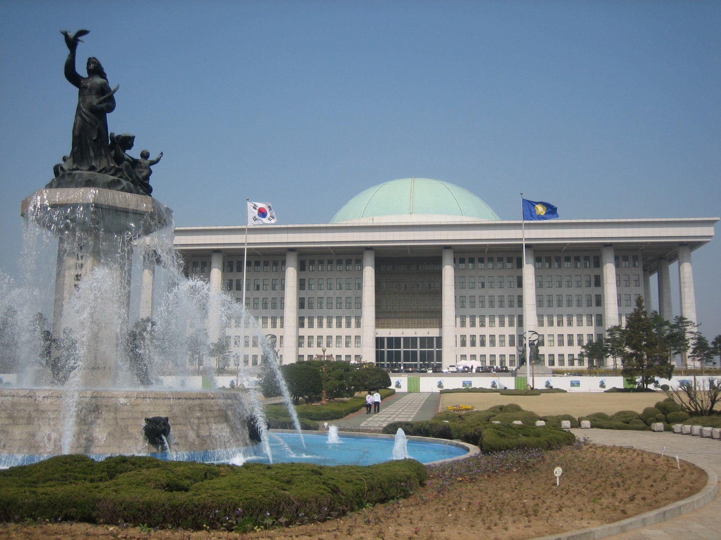
South Korea’s National Assembly Building
© Brain Wrinkles

Slide 35
Legislature
South Korea’s unicameral legislature is called the National Assembly.
About one-sixth of the legislature is chosen to represent national interests without going through an election.
The rest of the members are elected by South Koreans ages 19 and up.
© Brain Wrinkles

Slide 36
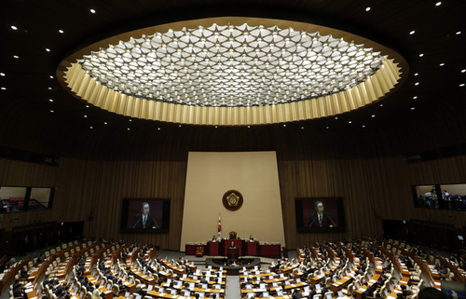
South Korea’s National Assembly
© Brain Wrinkles

Slide 37
Presidential
Democracy
South Korea has a presidential democracy.
Citizens directly elect the president.
The executive branch works independently of the legislative branch.
© Brain Wrinkles

Slide 38
Leadership
South Koreans directly elect a president to serve as head of state.
The president then appoints a prime minister (subject to confirmation by the National Assembly) to be the chief executive of government.
© Brain Wrinkles

Slide 39
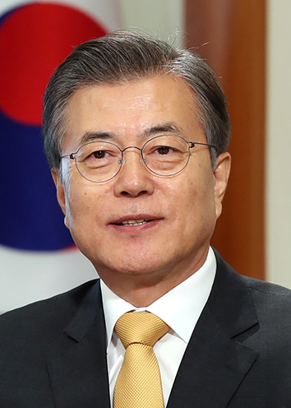
Moon Jae-in
South Korea’s President
© Brain Wrinkles

Slide 40
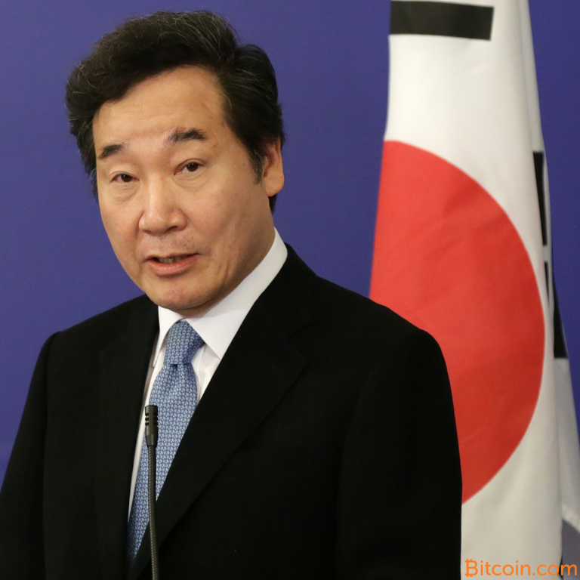
Lee Nak-yeon
South Korea’s Prime Minister
© Brain Wrinkles

Slide 41
Role of
Citizens
Citizens age 19 and older are free to vote or run for office.
South Koreans have a lot more influence over the government today than they did a couple decades ago.
South Korea’s constitution guarantees basic freedoms of speech, religion, the press, assembly, etc.
© Brain Wrinkles

Slide 42
Struggles
Unfortunately, freedoms for South Korea’s citizens are not absolute.
The government considers it a crime to express sympathy with North Korea.
The government also censors songs, books, and plays that are written in Japanese.
Also, workers from other Asian countries face discrimination in South Korea.
© Brain Wrinkles

Slide 43
AUTOCRACIES:
North Korea and China
© Brain Wrinkles

Slide 44
Autocracy
Autocratic governments rule in North Korea and China.
Government officials make decisions without any input from citizens.
The people do not have the option of changing the government through elections.
Citizens’ rights, such as free speech and right to assemble, are restricted by the government.
© Brain Wrinkles

Slide 45
NORTH KOREA
Autocracy
© Brain Wrinkles

Slide 46
Background
North Korea has a centralized government that is under the control of the communist Korean Workers’ Party.
All government officials belong to the KWP.
Since the country’s creation in 1948, it has been ruled by the Kim dynasty.
The exact structure of power is somewhat unclear, but the military supreme commander holds the most influence.
© Brain Wrinkles

Slide 47
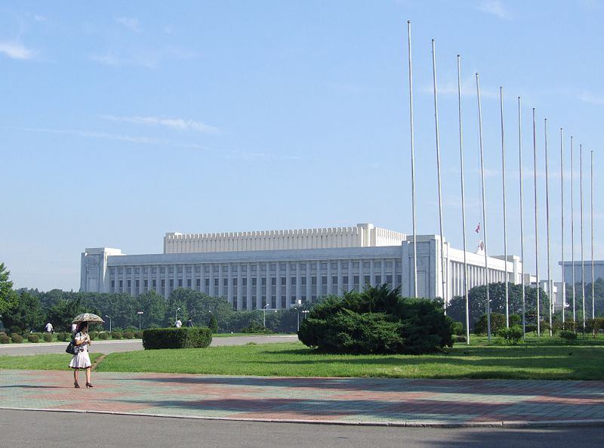
Supreme People’s Assembly
© Brain Wrinkles

Slide 48
Legislature
Citizens vote for a Supreme People’s Assembly, which serves as the legislature.
The Supreme People’s Assembly usually only meets twice a year and it mostly ratifies decisions already made by the KWP.
© Brain Wrinkles

Slide 49
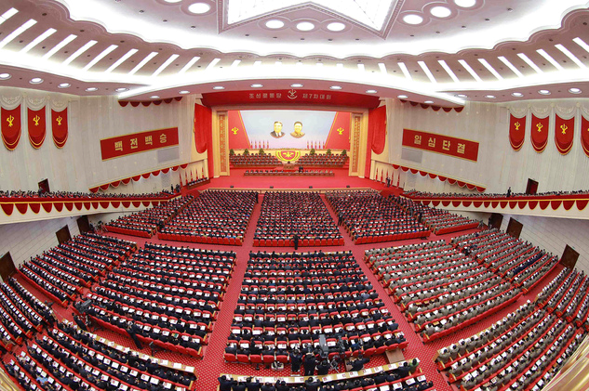
Supreme People’s Assembly
© Brain Wrinkles

Slide 50
Leadership
The military supreme leader is the highest office of the state.
North Korea also has a chief of state that serves as the head of state.
There is also a premier that leads the government and oversees the cabinet.
Both the premier and head of state must share power with the military supreme commander.
© Brain Wrinkles

Slide 51
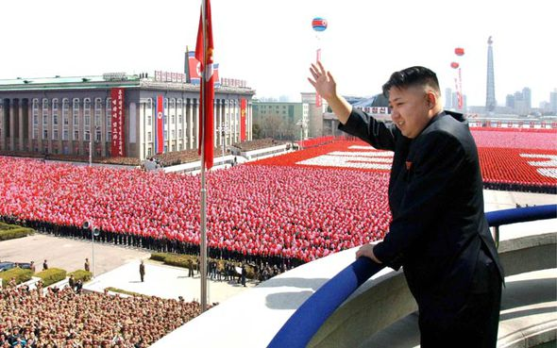
Kim Jong-un
North Korean Leader
© Brain Wrinkles

Slide 52
How Leaders
Are Chosen
The military supreme commander appears to be a hereditary position that has been passed down through three generations.
The Supreme People’s Assembly elects the chief of state and the premier.
© Brain Wrinkles

Slide 53
Autocracy
The Korean Workers’ Party is the center of North Korea’s government.
High-ranking KWP officials make decisions without answering to the citizens.
© Brain Wrinkles

Slide 54
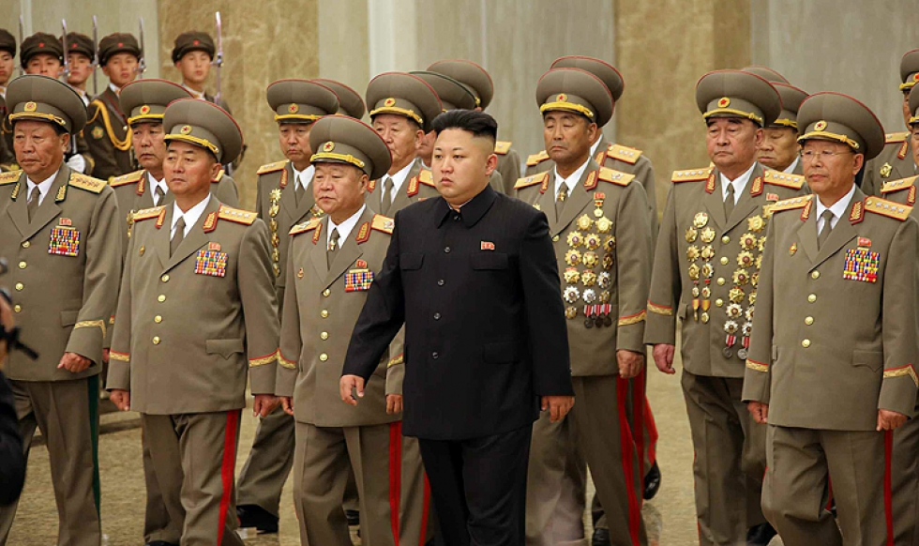
© Brain Wrinkles

Slide 55
Role of
Citizens
North Korean citizens can vote starting at age 17.
Only the Korean Workers’ Party can select candidates in this autocracy, so citizens don’t really have much influence on the government.
© Brain Wrinkles

Slide 56
Struggles
Rights such as freedom of religion, press, assembly, etc., are heavily restricted by the government.
North Korea has a serious lack of freedom of speech.
  There are only 3 TV channels (all government-owned), propaganda is announced from loudspeakers every morning, and there is no internet.
© Brain Wrinkles

Slide 57
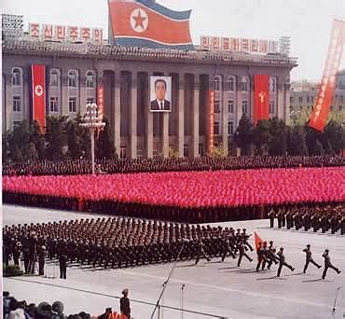
© Brain Wrinkles

Slide 58
Struggles
There is an extreme gap between the rich and poor in North Korea.
More than half of the population are malnourished and live in extreme poverty.
In the 1990s, a huge famine struck and killed hundreds of thousands of people.
© Brain Wrinkles

Slide 59
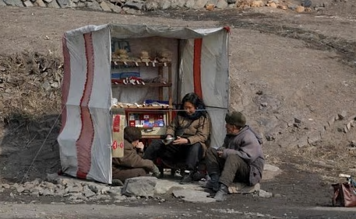
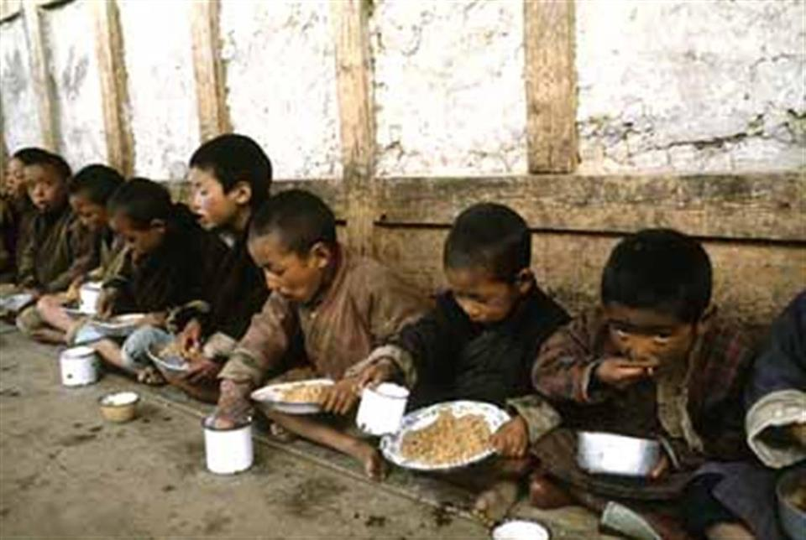
© Brain Wrinkles

Slide 60
CHINA
Communist State
© Brain Wrinkles

Slide 61
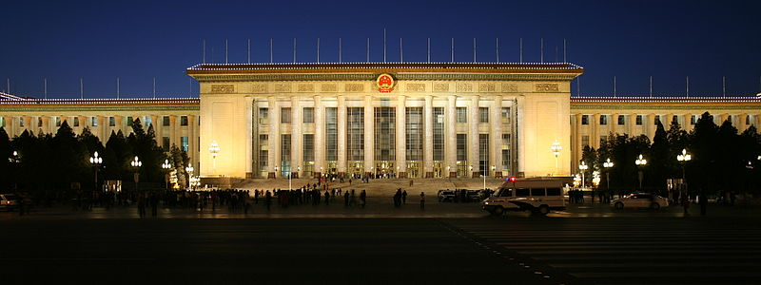
Great Hall of the People in Beijing
© Brain Wrinkles

Slide 62
Leadership
China has a president, who serves as the head of state. This is largely a ceremonial office that holds little political power.
The premier is the chief executive and is the highest ranking administrative official in China’s government.
© Brain Wrinkles

Slide 63
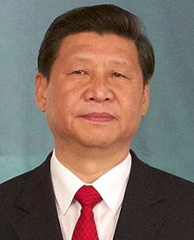
Xi Jinping
China’s President
© Brain Wrinkles

Slide 64
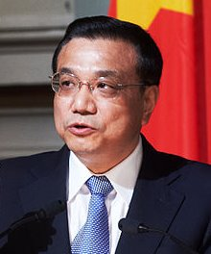
Li Keqiang
China’s Premier
© Brain Wrinkles

Slide 65
How Leaders
Are Chosen
China’s legislature elects the president.
The president nominates someone to be the premier, and the legislature confirms him or her.
© Brain Wrinkles

Slide 66
Legislature
The National People’s Congress is the country’s unicameral legislature.
Citizens 18 and over can vote in elections; however, only members of the Chinese Communist Party can be candidates in this Communist state.
Candidates are selected and approved by the government before the people can vote for them.
Members serve five-year terms.
© Brain Wrinkles

Slide 67
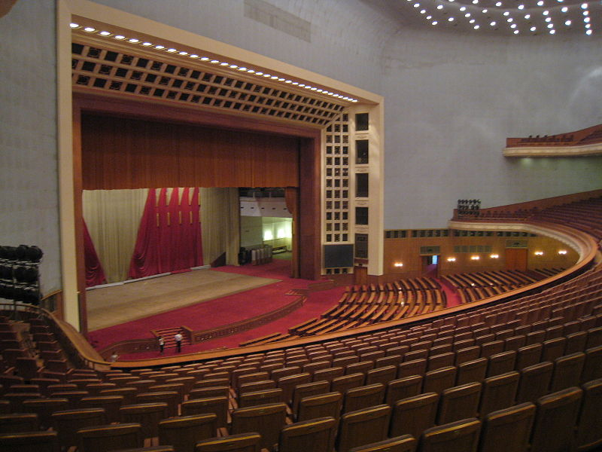
Great Hall of the People
(National People’s Congress Resides Here)
© Brain Wrinkles

Slide 68
Legislature
The National People’s Congress only meets for two weeks a year and mostly just approves decisions already made by the Communist Party.
© Brain Wrinkles

Slide 69
Role of
Citizens
At this time, it is not possible for Chinese citizens to change their government through elections.
Even though the constitution gives every person over 18 the right to vote, these rights are mostly meaningless because they are only allowed to vote for members of the Chinese Communist Party.
The government chooses the candidates and then dictates what they do once they are “elected”.
© Brain Wrinkles

Slide 70
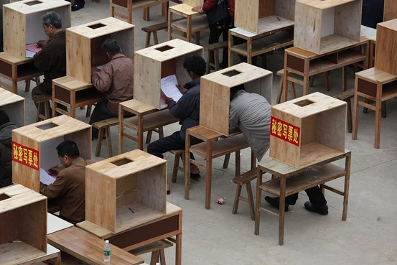
Voting in China*
*Chinese Communist Party is the only legal party, and officially sanctioned candidates run unopposed.
© Brain Wrinkles

Slide 71
Role of
Citizens
China’s communist government has a history of violating the personal freedoms of Chinese citizens by denying them basic rights such as freedom of speech and religion.
© Brain Wrinkles

Slide 72
Comparing SE Asian Governments
Directions: Complete the chart below after discussing the presentation.
Country | Type of Government | Executive Branch | How are leaders chosen? | Legislative Branch | Role of Citizen | Background Info & Struggles
India
Japan
South Korea
© Brain Wrinkles

Slide 73
Comparing SE Asian Governments
Directions: Complete the chart below after discussing the presentation.
Country | Type of Government | Executive Branch | How are leaders chosen? | Legislative Branch | Role of Citizen | Background Info & Struggles
North Korea
China
© Brain Wrinkles

